Slide 1

Category Code: C3
Problem Statement Title: FinEase: AI-Powered Autonomous Finance for Small Businesses
Team Name: Team INSPIRE
Institute Name: Vivekanand Education Society’s Institute of Technology

Slide 2

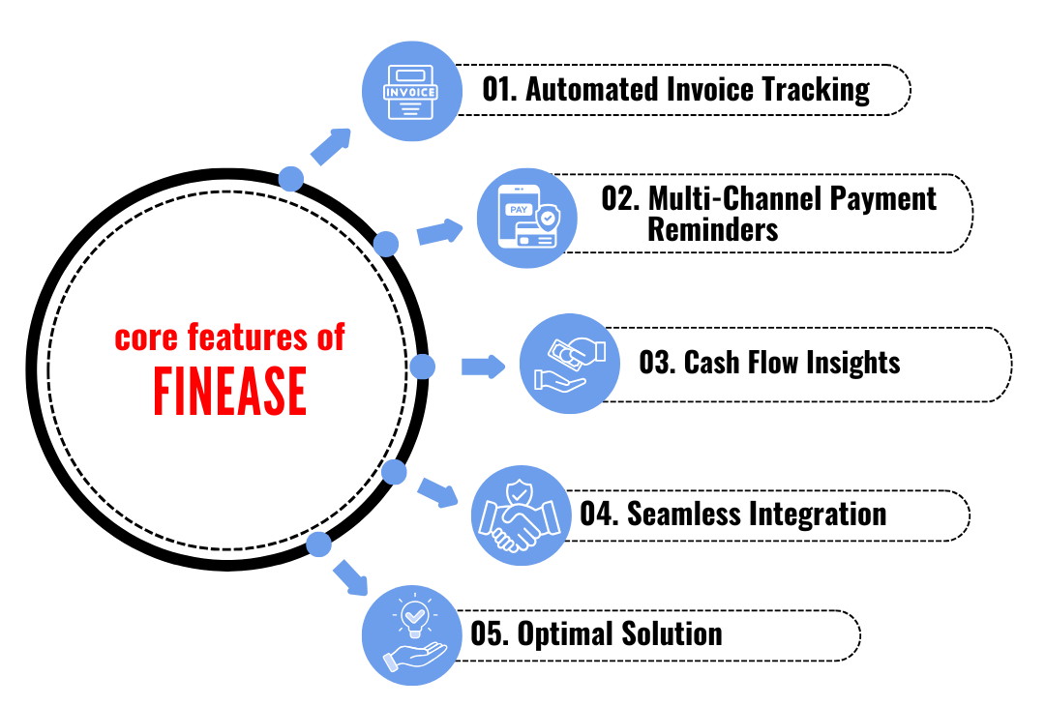
Idea / Approach details (& implemented features)
Problem Statement:
🔹 Small businesses struggle with financial
tracking, late payments, and debt risks.
🔹Traditional tools lack AI-driven insights for
smarter financial decisions.
Our Solution :
🔹 AI-powered financial tracking with real-time
updates.
🔹 Automated invoice generation & reminders
(email, WhatsApp, SMS).
🔹 Debt risk detection & priority-based payment
suggestions.
🔹 Predictive cash flow analysis using VectorDB
& AI.

Slide 3
Innovation (Showstopper)
Feature | Traditional Accounting Apps | FinEase
Invoice Tracking | Manual logging | Automated fetching & overdue detection
Reminders | Basic alerts | Smart multi-channel reminders (SMS, Email, WhatsApp, Slack)
Cash Flow Analysis | Manual input | AI-driven financial insights & forecasting
Integration | Limited | Seamless sync with QuickBooks, Xero, Zoho Books
Autonomy | User-dependent | AI-powered financial assistant
Unlike traditional accounting apps, FinEase is an AI-powered financial assistant that automates invoice tracking, detects overdue payments, sends smart reminders, and provides cash flow insights—minimizing manual effort.

Slide 4
Tech Stack
🔹 GenAI Models – GPT-4o for AI-powered financial insights
🔹 Frontend – ReactJS
🔹 Uptiq AI Workbench – For agent creation & workflow automation
🔹 Vector DBs – For data storage and transaction tracking
🔹 Twilio / Meta API – For SMS, WhatsApp, and email notifications
🔹 Razorpay / PayPal API – For automated supplier payments

Slide 5
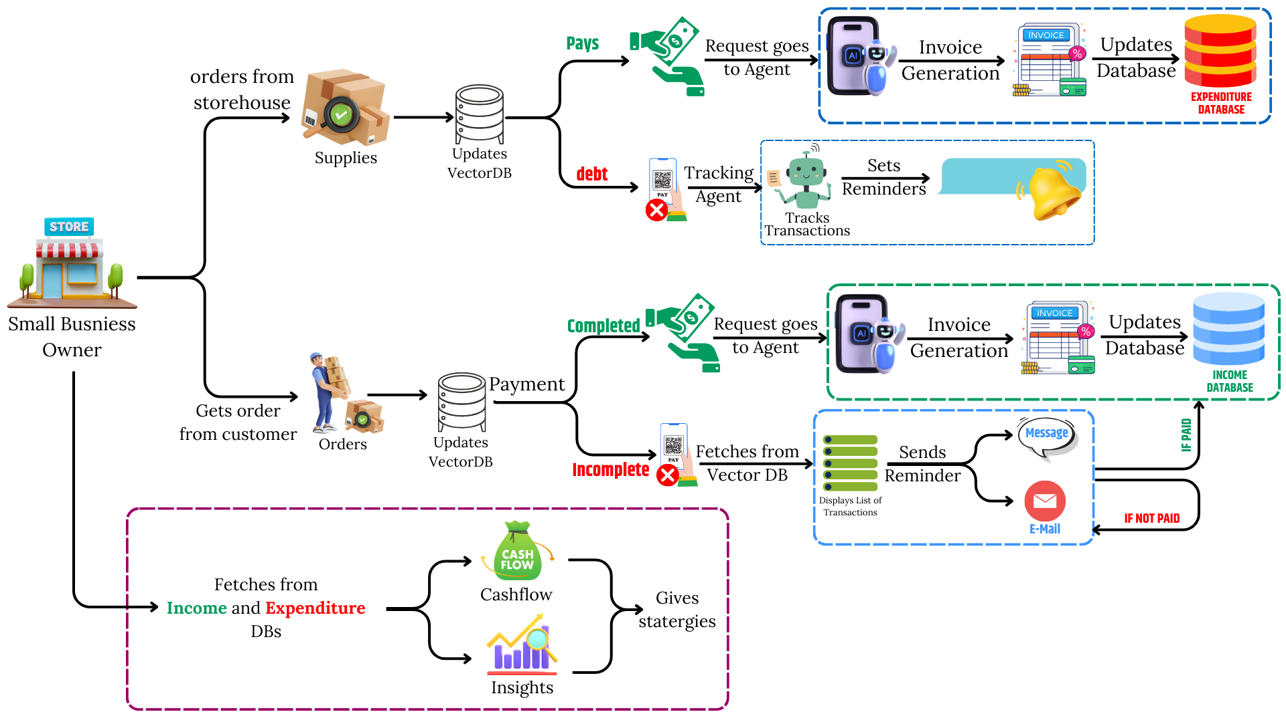
Implementation/Prototype/Use Case Diagram (screenshots)
Use Case Diagram
Documentation: Link

Slide 6
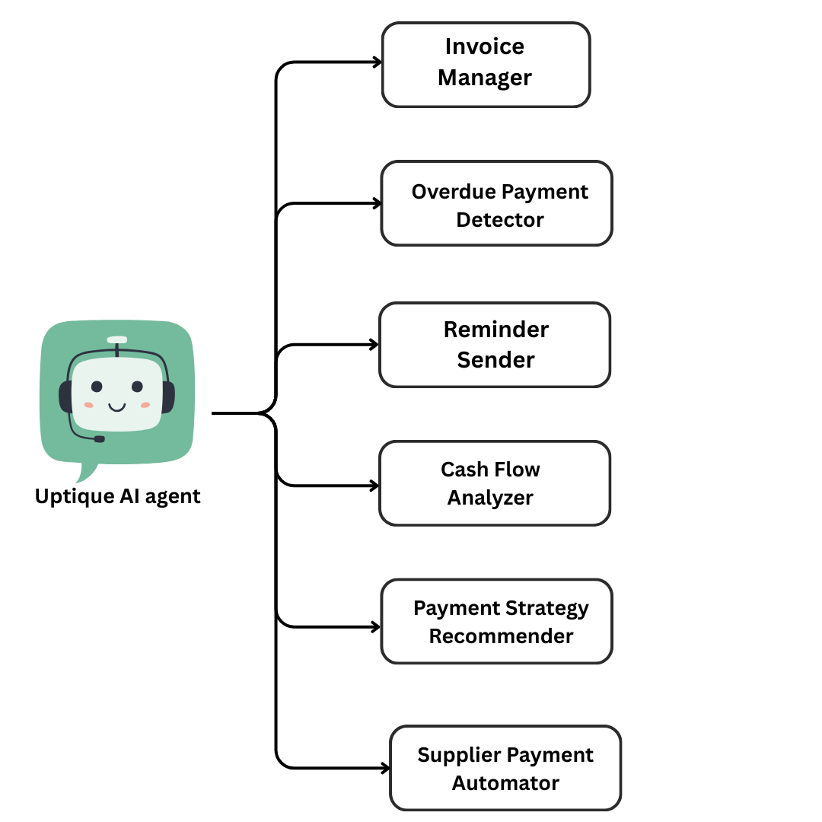
In case of Uptiq category - Your Uptiq Agent (explain in detail)
- Organizes and tracks all invoices, ensuring seamless financial management.
- Identifies late payments and flags them for quick resolution.
- Automatically notifies users and clients about pending payments via multiple channels
(Email, Slack,etc).
- Uses AI to assess financial health and predict cash flow trends based on Income
and Expenditure
- Suggests optimal payment schedules and methods for better financial stability.
- Automates recurring supplier payments to improve efficiency and avoid delays.

Slide 7
Future Objectives
Seamless User Authentication – Enable login via OAuth (Google, QuickBooks, Xero, etc.) or manual registration for a frictionless onboarding experience.
Voice-Enabled Financial Assistant – Allow users to query reports, track invoices, and receive insights through voice assistants for hands-free convenience.
Customizable Payment Workflows – Businesses can set tailored rules for reminders, follow-ups, and invoice tracking to fit their financial operations.
Automated Payments via Gateways – Integrate UPI, Stripe, Razorpay, and more to facilitate direct, automated invoice payments and reduce delays.

